Slide 1
ACTION RECOGNITION
COMPUTER VISION PRESENTATION Group-16

Slide 2
TABLE OF CONTENTS
01
02
03
04
Introduction
Objectives
Approach
Outcome

Slide 3
INTRODUCTION
Sign Language Detection
Action Recognition using LSTM Model
This project provides an in-depth demonstration of how the LSTM model can be employed to recognize sign language gestures from video frames in real-time. The video highlights the input and output of the LSTM model, the architecture of the neural network, and the training process using labeled data.

Slide 4
OBJECTIVES
Recognize sign language gestures and translate them into text or speech.
Achieve real-time detection of sign language gestures.
Ensure the system is robust to variations in lighting conditions, camera angle, hand sizes, and shapes.
Make the system user-friendly and intuitive for both the signer and receiver.
Ensure scalability and adaptability to different sign languages and dialects.

Slide 5

APPROACH
Extraction of Keypoints.
Collection of Keypoints.
Preprocess Data and create labels.
Build and Train LSTM Model.
Make Sign Language Predictions.

Slide 6
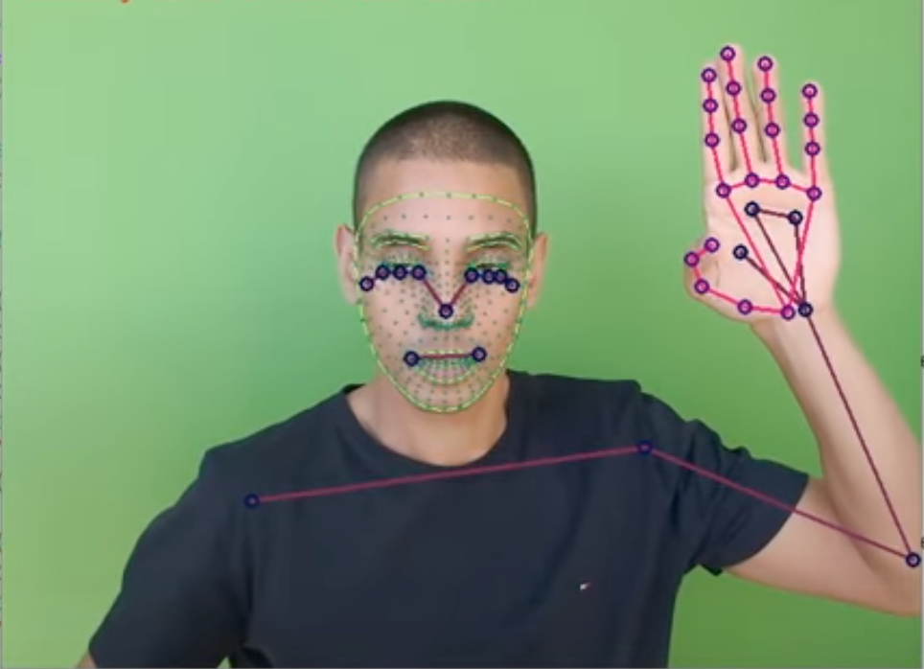
Extraction and Collection of Keypoints
The first step is to load the input video using OpenCV. This can be done using the cv2.VideoCapture() function.
Next, we initialize the MediaPipe Pose module using inbuilt mediapipe function which allows us to detect the body landmarks in each frame of the video.
We re then generating coordinates of the detected body landmarks for each frames.
The generated coordinates of the body landmarks are then stored in a data structure such as python list.
Finally, we are using OpenCV drawing functions to visualize the body landmarks on each frame of the video by looping through the list of landmark coordinates and drawing circles or lines on the video frame.

Slide 7
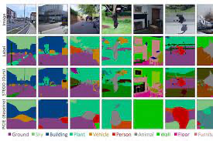
Preprocessing Data and Creating Labels
We create a test-train split between the data and create label maps to label each sequence frame array
Every sign is given a code which depicts the kind of action being performed.
We loop through each frame and append it to a window list, which later forms a video and is appended to the sequence array.
We set up the training and testing part of our data (5% test) and prepare for the next step i.e. LSTM (RNN) to classify the data accordingly.

Slide 8
Why LSTM Model ?
Long Short-Term Memory (LSTM) model, which is a type of recurrent neural network (RNN) commonly used for sequence data processing.
LSTM models can effectively learn from sequences of data while CNNs are typically designed for image-based data.
Less data required to produce a large amount of data.
Faster training as it is way denser.
Faster detections.

Slide 9
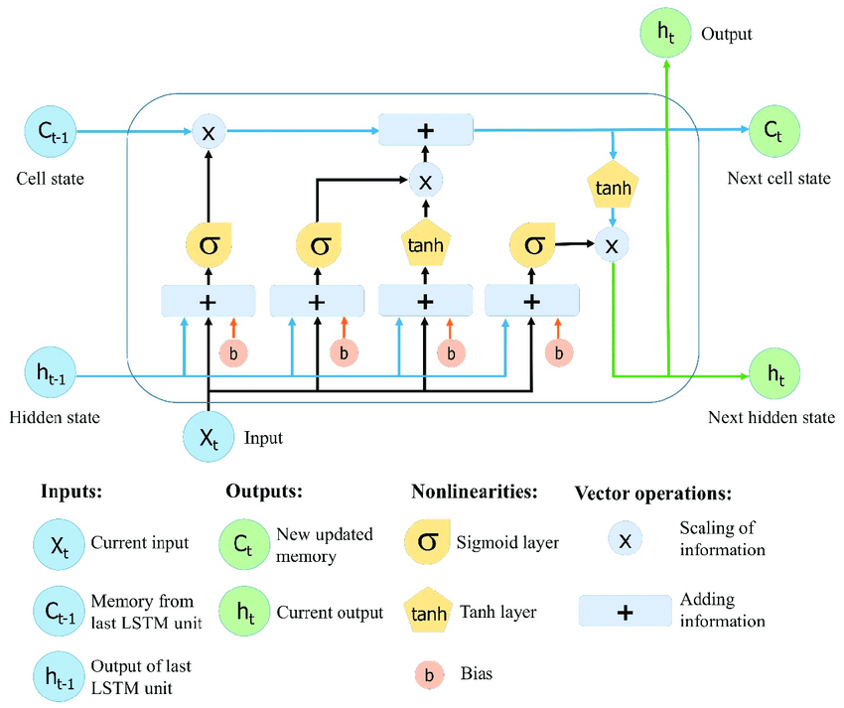
LSTM Architecture
Input Gate: The input gate is responsible for determining how much of the new input should be added to the current cell state. It takes the current input and the previous hidden state and passes them through a sigmoid activation function. The resulting product is then added to the current cell state to update it.
Forget Gate: The forget gate determines how much of the information from the previous cell state should be retained or forgotten.
Output Gate: It takes the current input and the previous hidden state as inputs and passes them through a sigmoid activation function. The output of the sigmoid function is multiplied element-wise which is passed through a tanh activation function to squash the values between -1 and 1.

Slide 10
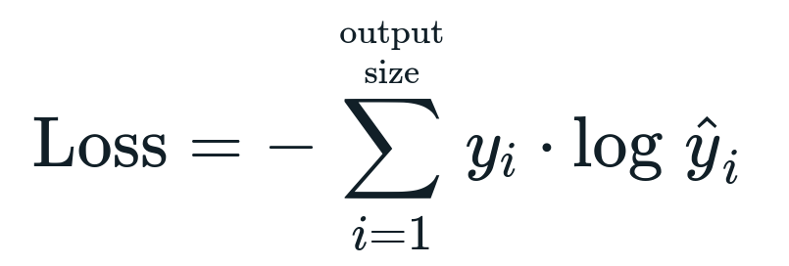
Categorical Cross Entropy Loss Function
It measures the discrepancy between the predicted probability distribution and the ground truth labels.
Cross-entropy loss has several desirable properties such as gradient descent, to minimize the categorical cross-entropy loss. The gradient of the loss with respect to the model's parameters is used to update the parameters, iteratively improving the model's predictions and also penalizes larger prediction errors heavily.
Another advantage of cross-entropy loss is that it can handle multi-class scenarios, where each input can belong to one of several possible classes, as in the sign language detection task in the video.

Slide 11
Implementation of LSTM
The training model is built using multiple layers of LSTM models and fully connected dense neural networks.
The input to the LSTM model is a sequence of video frames that capture sign language gestures. These video frames are typically preprocessed to extract relevant features(ie extracted keypoints) such as hand movements, body poses, and facial expressions.
During training, the LSTM model is optimized using a labeled dataset of sign language gestures and the cross entropy loss function.
Once the LSTM model is trained, it can be used for sign language detection in real-time. During inference, the model takes new video frames as input and predicts the sign language label based on the learned patterns from the training data.

Slide 12


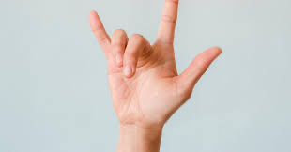
Output Expected
Hello
Thanks
I Love You

Slide 13

Results

Slide 14
References
Cheng, G., Wan, Y., Saudagar, A. N., Namuduri, K., & Buckles, B. P. (2015). Advances in human action recognition: A survey. arXiv preprint arXiv:1501.05964.
Dai, C., Liu, X., & Lai, J. (2020). Human action recognition using two-stream attention based LSTM networks. Applied soft computing, 86, 105820.

Slide 15
Thank You
Team Details:
Sanju Sabu - S20200010187 Yash Gupta - S20200010234 Madhur Saxena - S20200010115 Meet Jain - S20200010126

